Slide 1
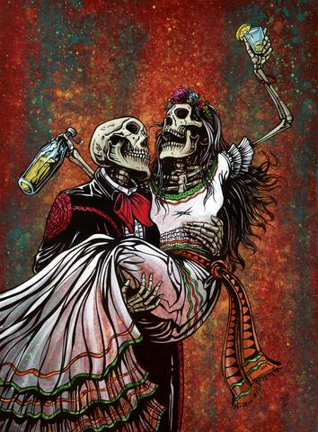
Comparative Study
By Marcela Callapina
Introduction:
Culture can be demonstrated by arranged marriages, parent’s expectations, exquisite food, language, unique traditions. My comparative study focuses on two artists who express and explain the Mexican culture through art-- Frida Kahlo and Celeste Contreras. Meanwhile they apply emotion from current events. I was first introduced to Frida Kahlo in Spanish class. We analyzed the connection between her artwork and feelings/culture. As I started doing my art pieces, I discovered multiple local artists near me, for example, Celeste Contreras. I was hypnotized by her artwork and the way she manipulated patterns and design.
Lozeau, David. Bottoms Up. 2016. Painting . Day of the Dead, n.p.

Slide 2
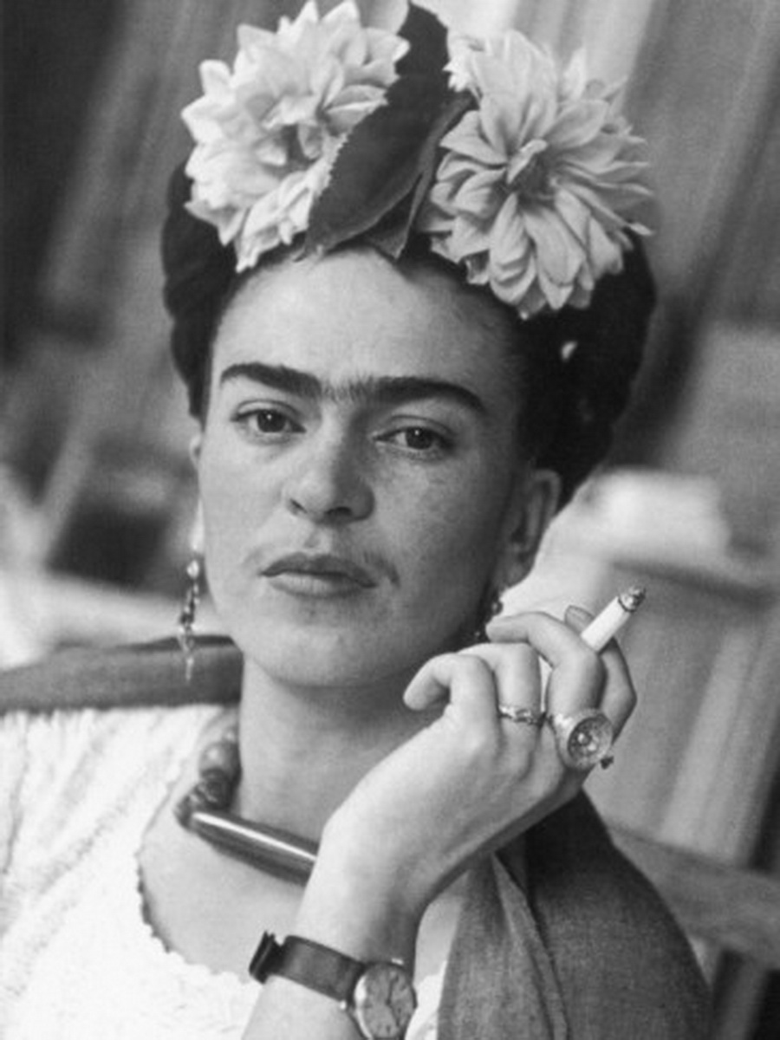
Frida Kahlo- Symbolism or Surrealism Artist
Frida Kahlo is the most famous Mexican woman painter. Although she lived a complicated and dramatic life, she conquered the world with her artwork. They reflect the emotions of her turbulent relationship with Diego Rivera, the long lasting pain she endured as a result of a tragic bus accident and her inability to have children. Kahlo lived two lives: Diego Rivera’s wife and the talented Mexican painter. Critics identified her as a surrealist thought she denied. “I paint self portraits because I am so often alone, because I know myself best” - Frida Kahlo
"Frida Kahlo: una retrospettiva all'insegna dell'autoritratto. Alle Scuderie del Quirinale – Storie." Storie. N.p., 18 Feb. 2014. Web. 01 Oct. 2016. <http://www.storie.it/arte/frida-kahlo-una-retrospettiva-allinsegna-dellautoritratto-alle-scuderie-del-quirinale/>.

Slide 3
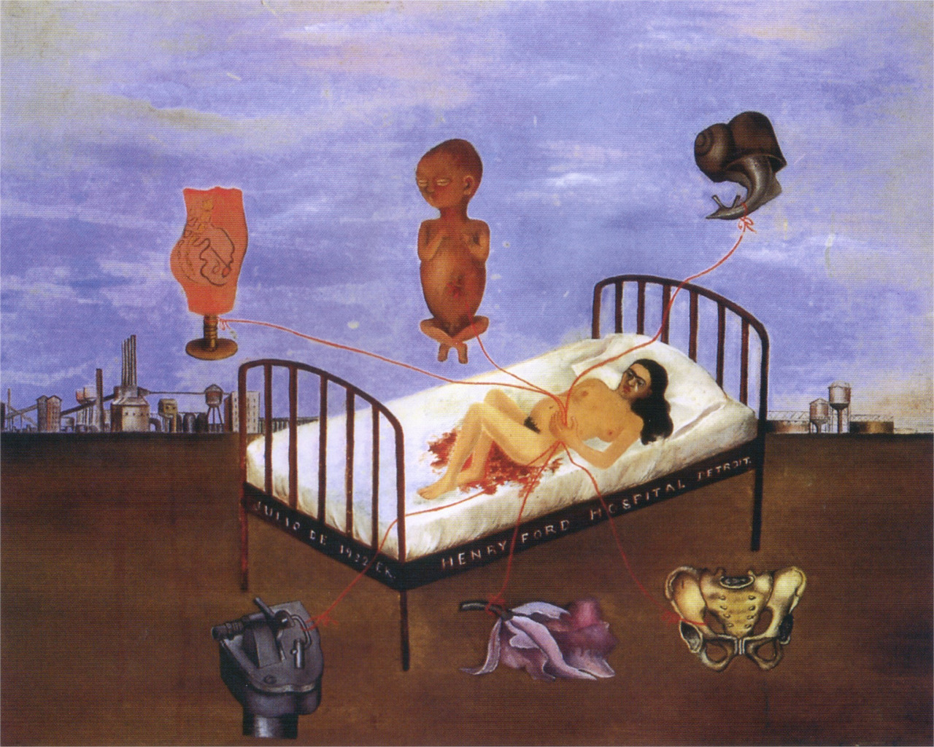
Techniques and Art Style
Frida Kahlo didn’t have specific techniques when it came to painting, unlike other artists. Most of her inspiration came from her own life.
If her art pieces were to be analyzed, it can be said the colors she used had a meaning behind it. She used green, magenta, brown, yellow, blue, black, red. Majority of her paintings stay within this color range, to signify her gloomy life. She kept a journal with dozens of drawing, with techniques learned from both her father and husband. Not to mention that she never attended school therefore had no formal training in how to paint. Overall her art style was combined of her Mexican culture, surrealism, symbolism and her personal life; tragic car accident, miscarriages and her marriage being a failure. It’s seen in her paintings, she depicts animals that symbolize the tone of her pieces.
Kahlo, Frida . Henry Ford Hospital. 1932. N.p.

Slide 4
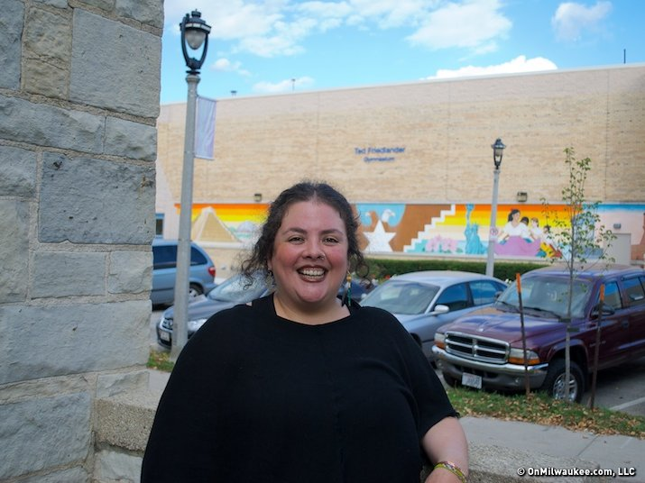
Celeste Contreras- Local Artist in Milwaukee
Celeste Contreras is a local artists in Milwaukee, Wisconsin. She considers herself, an artist, activist, student and teacher. She’s currently studying at Alverno College, majoring to be a middle school art teacher. Her artwork reflects her past experiences that shape who she is now. Such as rebirth, death and family. She is influenced by living abroad in other countries, her family history, and folk art from different countries. When she was living in Thailand, she experienced the death of her host. Afterwards she moved to Mexico to find her roots, and she learned more deeply about death, culture, tradition, as well as experiencing El Dia de los Muertos. Going through traumatic events and finding her roots shaped her aim as an artist.
"Contreras marches the Dia de los Muertos parade into Milwaukee." OnMilwaukee.com. N.p., n.d. Web. 14 Oct. 2016. <https://onmilwaukee.com/ent/articles/diadelosmuertosparadecontreras.html>.

Slide 5
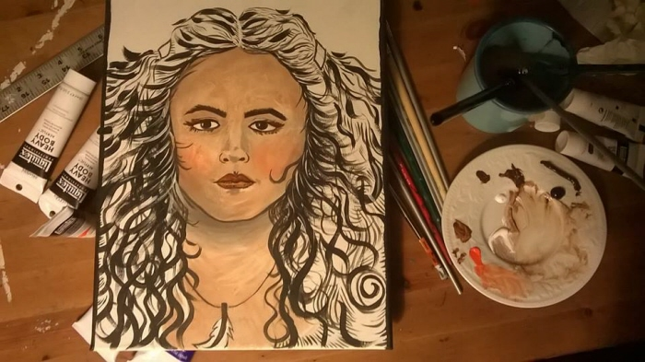
Techniques and Art Style
Celeste Contreras also uses her own experience to make art work. Such as death’s she’s personally experienced and her Mexican culture. Her expertise are self portraits drawings, three-dimensional shrines, and paintings. For her self portraits she designs patterns and contributes it, covering her nose right under her eyes. It can be said, it became a habit.In her shrines, she uses found objects, hand made wood pieces, and mixed media. For paintings overall, she uses ink, paint, charcoal, paper, board, and canvas. Celeste uses a mixture of materials-- mixed media, which reflects the way her hand and heart let her create in the world.
"Self-Portraits by Celeste Contreras at Coroflot.com." Coroflot. N.p., n.d. Web. 10 Oct. 2016.

Slide 6
Cultural and History Comparison
Celeste Contreras
Frida Kahlo
Surrealism artist-- majority of painting she’s hurt physically and mentally
Experienced her hostess death
All types of mediums: ink, paint, paper, board, canvas and combines to make a mixed media
Mexican culture (traditional clothing, traditions such as Dia de los Muertos)
Inspiration came from past experiences, trauma from deaths
Paintings is their strongest medium
Experienced miscarriage, failure of marriage with Diego Rivera, bus accident
Practices design and patterns on majority of her art pieces
Painted WHILE she was in pain, her artwork was made while she was dealing with her pain
Didn’t go against any Mexican rules, because expectations have been adjusted in the 21st century
Uses objects in her painting to symbolize her pain etc
Dia de Los Muertos inspired art
Inspired by Swoon, architect, printer, artist. And Martin Ramirez a Mexican artist.

Slide 7
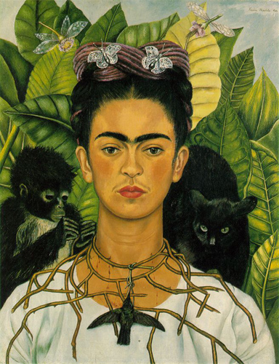
Self Portrait with Thorn Necklace and Hummingbird
Oil on Canvas
Out of all Frida’s self portraits, I chose this one due to its simplicity and me having a relationship to it.
In this art piece, Frida Kahlo secretly exposes the status of her relationship. Also, she uses objects to signify her feelings and what she’s dealing with. The necklace around her neck having her bleed, represents how she's a Christian martyr who is still suffering over her divorce with Diego Rivera. This was painted right after her divorce. Connected to her necklace is a hummingbird hanging dead. In Mexican tradition a dead hummingbird were used to bring luck in love. The black cat on her left shoulder, symbolizing bad luck and death. On her right shoulder, is the monkey Diego Rivera gave Frida as a gift. Which symbolizes the devil. Overall, in this painting Frida expresses her feeling through symbols. Again reflects her pain, in this painting she suffers because her and Diego Rivera, the love of her life are separating.
Kahlo, Frida. Self Portrait with Thorn Necklace and Hummingbird. 1940. Painting . N.p.

Slide 8
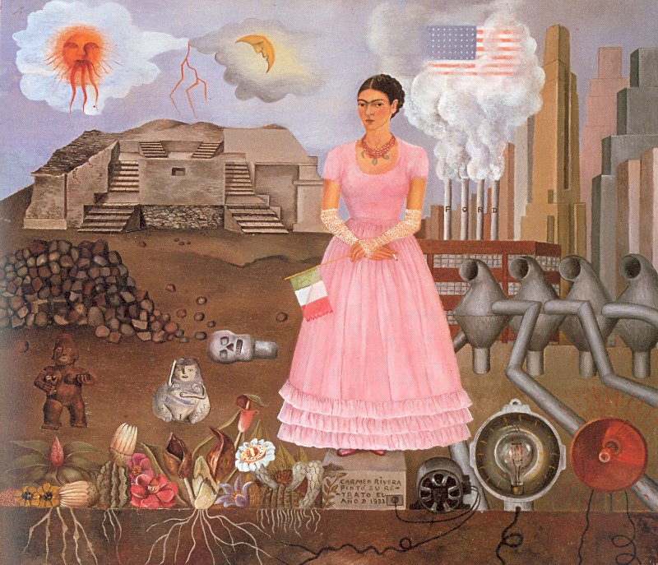
Self Portrait Along the Borderline Between Mexico and the United States
Second painting I chose by Kahlo is strongly related to her culture and the US culture. Also, again she expresses her feelings through her art work.
It was painted in 1972, Frida has been in the USA for three years and had started growing sick for Mexico. In her hands she hold a Mexican flag signifying her loyalty for Mexico. While her right hand holds a cigarette. As it obvious, the canvas is split into two worlds, Mexico and the USA. On one side, the ancient Mexico landscape and Aztec sculptures lay. On the other side Frida describes it through her painting as a cold country. Mainly dominated with technology and ran by factories. Her main reason to travel to USA was because of Diego Rivera, she didn’t realize her love for Mexico was deep enough to affect her.
Kahlo, Frida. Self Portrait Along the Boarder Line Between Mexico and the United States. 1932. Painting. N.p.

Slide 9
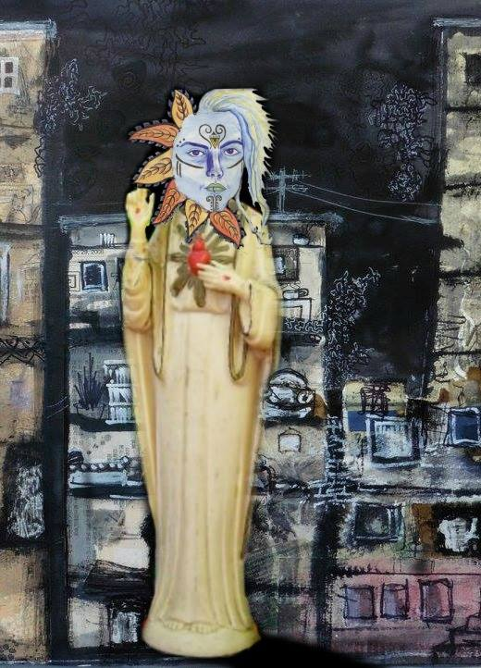
Untitled Mixed Media
I chose this art piece by Celeste Contreras, because it reflected my personal interests, mixed media, by it being composed of multiple mediums.This composition is created from three separate art pieces. The buildings in the background are called Palimpsest and memory apARTment series. This is a collage inspired by her past apartment drawings and Martin Ramirez, a Mexican artist. Who came to the US in the 1930’s, because of the extreme culture shock he was placed in a asylum, and named insane because he became mute. He would hide scraps of paper, and save his mashed potatoes and bread to create his own glue, using water or his own saliva. Thought his doctor supported his artistic endeavors and saved his art work. The face is a self portrait she drew when she was in Mexico, hitchhiking around her spiritual Journey to the Mother Landia in 2003-4. The body on the art piece is a small saint statue owned by Contreras. I
"Digital." Celestazuchitl.wordpress.com. N.p., 09 May 2016. Web. 11 Oct. 2016.

Slide 10
Comparing Works
Self Portrait with the Thorn Necklace….
Both
Mixed Media
Kahlo’s aim is getting hurt with the thorn necklace
Manipulates the black monkey and cat (symbolism)
Medium: Painting
Paints herself in a literal manner. Direct and honest with face details. Such as her mustache and unibrow.
Unlike other self portraits she chooses vibrant summer colors.
Include nature, in some way. In both there are leafs as their background or behind their face
Colors match and stay within the theme or message.
Inspiration come from their Mexican culture. Frida is most likely wearing a white blouse or dress. Contreras uses a statue of a Mexican saint.
Uses found objects
Medium: drawing, found object, and painting. Combined all medium= mixed media
Uses modern technology such as Photoshop.
Has a design happening on her face.

Slide 11
Similarities
In both art pieces, the use of leafs are taken place either as background or by the face. Frida emphasizes her cheekbones with a brown tone. Celeste as well emphasizes her cheekbones, with a different technique, a line. Both artists provide movement. Celeste’s designs and patterns influence the viewer to see movement, with the leafs and circular non ending lines, also the tips of her hair. Frida provides movement because of the butterflies and the headband design.

Slide 12
Differences
The main difference between both pieces are the colors. Celeste chooses blue as her principal color. Her background is filled with dark colors giving a gloomy mood. Around her face she uses fall colors, such as yellow and orange. Unlike Frida who used summer vibrant colors. Her background is of leaves with different shades of green. Celeste’s face is not as realistic as Kahlo’s because she uses lines for face details. Also because she uses light blue for her skin tone. Ulike Frida who uses shading and her real skin tone for her face details. Lastly Frida incorporates animals and nature. On the other hand Celeste is on a different theme, such as buildings.

Slide 13
Comparing Both Frida art pieces
Self Portrait Along the Borderline Between Mexico and the United States
Self Portrait with Thorn Necklace and Hummingbird
Both
1940
Repetition is formed with her eyebrows and the hummingbird.
Manipulates color. Uses a hint of yellow on the leaves to give a vivid look.
Frida uses the “flicking” method to add a hint of white on black. On her and the animals hair.
Isn’t afraid to show her “flaws” : mustache and unibrow
Mexican culture is seen through her outfits.
Demonstrates her use of nature, with the flowers, leaves, dry mud, and clouds.
Exposes her personality.
1932
Variety of action within art piece.
Expresses her view and opinion on Mexico and the United States.
Applies neutral colors.
Creates space throughout the painting.
Compares Mexico and the United States.

Slide 14
Similarities
Both paintings are self portraits by Frida Kahlo. They both show her current emotions towards an event she went through. She shows it off by hurting herself with the thorn necklace. If looked very closely, she’s bleeding, symbolizing how she’s still hurting. In 1930 Frida experiences a miscarriage at Henry Ford Hospital. An event she would never forget because Diego Rivera never wanted kids and right after she traveled to the USA for three years. She used this an opportunity to forget but this is contradicted in her painting. In both painting Frida has an object on her neck. Such as the thorn necklace or a necklace of beads. Like in majority of Frida Kahlo’s self portraits, she involves nature such as flowers and plants. Lastly in both paintings, Frida Kahlo has the same hair style, a braid in a bun.

Slide 15
Differences
Even though both paintings are from the same artist, the dates change. Unlike Frida’s most self portraits, she used multiple direct symbolism. When representing Mexican culture, like the Aztec sculptures on the ground and the Mexican flag she’s holding. This may also represent where her loyalty stands. In the same piece, she’s comparing Mexico to the US, visually describing the US with factories and technology. While on the left, she leaves the viewer guessing on what’s happening. Secondly her “pose”. Oftenly she paints her self portrait looking to the right, however in the Self Portrait with the Thorn Necklace and Hummingbird, she’s looking straight, to show her being firm.

Slide 16
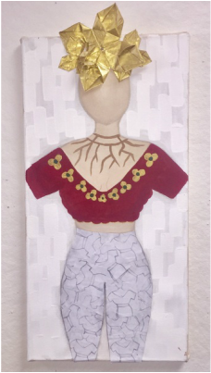
Modern Fashion- Personal Piece
For this art piece, I chose to be heavily inspired by Frida Kahlo and Celeste Contreras. The main concepts I focused on was fashion, repetition of design and combining mediums. Which was practiced in this art piece. Aside from artistic techniques, I also included a meaning behind this piece. My first art pieces were about fashion or a design I would create myself. However, I started to experiment other mediums, art movements, and was introduced to international talented artists. Therefore I decided to end my senior year with a piece that showed everything I learned, enjoyed and represented me as an artist. This is a mixed media: painting, drawing, photoshop and origami. Overall my message is that we should allow ourselves to face challenges and experiment, but never forget how you started off.

Slide 17
Comparing Personal Art Piece to Frida Kahlo’s self Portrait
Self Portrait With Thorn Necklace and Hummingbird
Modern Fashion
Use of 3D handmade objects--origami.
Dabbing technique is used for the background.
Layers were applied onto painting.
Drawing and manipulation of Photoshop were considered.
For pants: scotch was used to glue
Use of tertiary and artificial colors. (gold and burgundy)
Painting is composed of natural and primary colors.
Shows AND includes face details.
Pursues the use of shading and blending.
Composition of details are placed alike
Thorn necklace
Have a connection to nature.

Slide 18
Fashion-- Style
All three painting have an object on their chest, and around the neck. There’s a huge similarities, the thorn necklace.
The blouse is open, almost close to the shoulders. Shaped in a “V” or “U”
Although, in both Frida’s painting, their outfits, such as blouse and dress are of soft colors. Unlike mine, I use burgundy.
In my art piece and both of Frida’s art pieces, there’s a detail placed on top of the head.
Use of flowers, plants & nature.

Slide 19
Repetition of Design
Design is repeated.
Modern art is within the art piece
The background is repeated horizontally. For my art piece, the background is white and there are blocks of white rectangles.
Celeste uses buildings in a different manner.
There’s patterns surrounding Celeste’s face, constantly repeating. For my art piece, there’s replication of drawings for my subject’s pants.

Slide 20
Mediums
I combine all three different mediums, origami, drawing/photoshop, and painting.
Celeste and I also use of an object. Except for the final art piece, Celeste’s ends in 2D, mine is 3D.
Since Celeste and I are from the same time period, we both had the opportunity to use technology. Therefore we took advantage of the power of Photoshop.
Painting was a heavy influencer for us both artists, but if we compare our techniques and choices, it differs from Frida Kahlo’s.
Overall, my aim was to compare and contrast my and Celeste Contreras’ artwork to Frida Kahlo. Due to the time period difference. I believe we were both strongly exposed to different options and inspirations, again because the time difference.

